Slide 1
Data Warehousing and Business Intelligence
Business Information Systems – 420-E01
References:
Chapter 4 & 11: Rainer, Introduction to Information Systems. 2^{nd Canadian} ed.
Chapter 7: Baltzan, Business Driven Information Systems, 3rd Canadian ed.

Slide 2
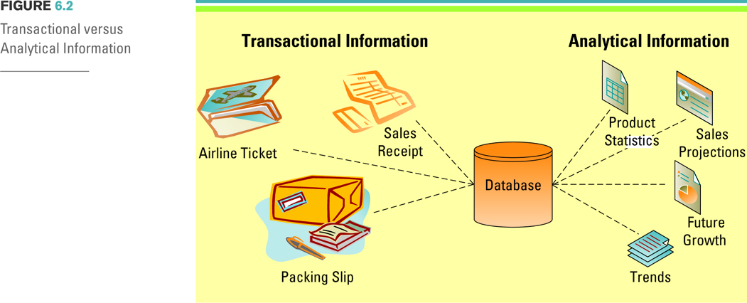
Transactional Data & Analytical Information
Notes:
Organizations capture and store transactional information in databases and use it when performing operational tasks and repetitive decisions such as analyzing daily sales reports and production schedules
Transactional information examples include withdrawing cash from an ATM, making an airline reservation, purchasing stocks
Compile a list of additional transactional information examples
These could include daily sales, hourly employee payroll, product orders, shipping an order
Analytical information includes transactional information
Analytical information also includes external organizational information such as market, industry, and economic conditions
Analytical information is used to make ad-hoc decisions
Analytical information examples include trends, sales, product statistics, and future growth projections
Compile a list of additional analytical information examples
These could include cost/benefit analysis, sales forecast, market trends, industry trends, and regulations
Ask your students to compile a list of the different types of ad-hoc decisions a business might base on analytical information
These could include building a new plant, hiring or reducing workforces, introducing a new product

Slide 3
The Costs of Poor Information
Potential business effects resulting from low quality information include:
Inability to accurately track customers.
Difficulty identifying valuable customers.
Inability to identify selling opportunities.
Marketing to nonexistent customers.
Difficulty tracking revenue due to inaccurate invoices.
Inability to build strong customer relationships.
Notes:
Can you list any additional business effects resulting from poor information? (focus on organizational strategies such as SCM, CRM, and ERP)
Poor information could cause the SCM system to order too much inventory from a supplier based on inaccurate orders
Poor information could cause a CRM system to send an expensive promotional item (such as a fruit basket) to the wrong address of one of its best customers
What occurs when you have the inability to build strong customer relationships?
Increase buyer power
Gartner podcasts are excellent course resources, there is current a good podcast on the cost of poor data to an organization
http://www.gartner.com/it/products/podcasting/asset_145611_2575.jsp

Slide 4
The Benefits of Good Information
High-quality information can significantly improve the chances of making a good decision.
Good decisions can directly impact an organization's bottom line.
Notes:
CLASSROOM EXERCISE
Understanding Information’s Quality
Break your students into groups and ask them to compile a list of all of the issues found in the table on page 5 of the Chapter 7 Instructor’s Manual – cut and paste onto a slide or display on the projector)
Ask your students to also list why most low quality information errors occur and what an organization can do to help implement high quality information

Slide 5
History of Data Warehousing
Data warehouses extend the transformation of data into information.
In the 1990’s executives became less concerned with the day-to-day business operations and more concerned with overall business functions.
The data warehouse provided the ability to support decision making without disrupting the day-to-day operations.
Notes:
GREAT BUSINESS DECISIONS – Bill Inmon – The Father of the Data Warehouse
Bill Inmon, is recognized as the "father of the data warehouse" and co-creator of the "Corporate Information Factory." He has 35 years of experience in database technology management and data warehouse design. He is known globally for his seminars on developing data warehouses and has been a keynote speaker for every major computing association and many industry conferences, seminars, and tradeshows.
As an author, Bill has written about a variety of topics on the building, usage, and maintenance of the data warehouse and the Corporate Information Factory. He has written more than 650 articles, many of them published in major computer journals such as Datamation, ComputerWorld, DM Review and Byte Magazine. Bill currently publishes a free weekly newsletter for the Business Intelligence Network, and has been a major contributor since its inception. http://www.b-eye-network.com/home/

Slide 6
The Need for Data Warehousing
Today, the most successful organizations are those that can respond quickly to market changes and opportunities.
Access to corporate data is vital for managers so they can analyze the data and make decisions

Slide 7
Example
If the manager of a local bookstore wants to know the profit margin on used books at her store, she could find out from her database, using SQL.
If she wants to know the trend in the profit margins on used books over the last 10 years, this would be a difficult SQL query.
This info exists in the database, but is not organized to be quickly found.
Data warehousing makes it easier and faster for users to access and query data.

Slide 8
Data Warehouse - Definition
A data warehouse is a repository of historical data organized by subject to support decision makers in the organization.
It’s a logical collection of information that is gathered from many different operational databases
The primary purpose of a data warehouse is to aggregate information throughout an organization into a single repository for decision-making.
Data warehouses facilitate business intelligence activities.

Slide 9
Extract, Transform, Load
Extraction, transformation, and loading (ETL)
a process that extracts information from internal and external databases, transforms the information using a common set of enterprise definitions, and loads the information into a data warehouse.
Notes:
The ETL process gathers data from the internal and external databases and passes it to the data warehouse.
The ETL process also gathers data from the data warehouse and passes it to the data marts.

Slide 10
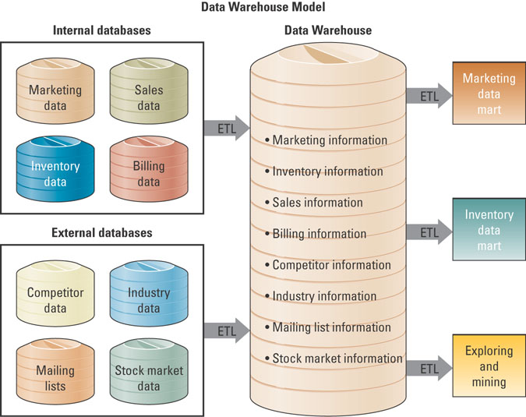
Data Warehouse Fundamentals
Figure 7.11
Notes:
The data warehouse modeled in the above figure compiles information from internal databases or transactional/operational databases and external databases through ETL.
It then send subsets of information to the data marts through the ETL process.
Ask your students to distinguish between a data warehouse and a data mart?
Ans: A data warehouse has an enterprise-wide organizational focus, while a data mart focuses on a subset of information for a given business unit such as finance.

Slide 11
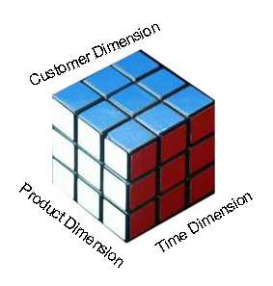
Data Warehousing Characteristics
Subject oriented - Organized by business dimension or subject
Consistent – all data encoded in consistent manner
Historical – data kept for many years, for trends
Non-volatile – data doesn’t change once in warehouse
Multidimensional – data cube
Relationship with relational databases

Slide 12
Multi-dimensional Analysis
Databases contain information in a series of two-dimensional tables.
In a data warehouse and data mart, information is multi-dimensional. it contains layers of columns and rows
Dimension – a particular characteristic of the information; an attribute.
Cube—common term for the representation of multi-dimensional information.
Notes:
Each layer in a data warehouse or data mart represents information according to an additional dimension
Dimensions could include such things as:
Products
Promotions
Stores
Category
Region
Stock price
Date
Time
Weather
Why is the ability to look at information based on different dimensions critical to a business’s success?
Ans: The ability to look at information from different dimensions can add tremendous business insight
By slicing-and-dicing the information a business can uncover great unexpected insights.

Slide 13
Multi-dimensional Analysis
The data cube has three dimensions: customer, product, and time.
Historical data in data warehouses can be used for identifying trends, forecasting, and making comparisons over time.

Slide 14
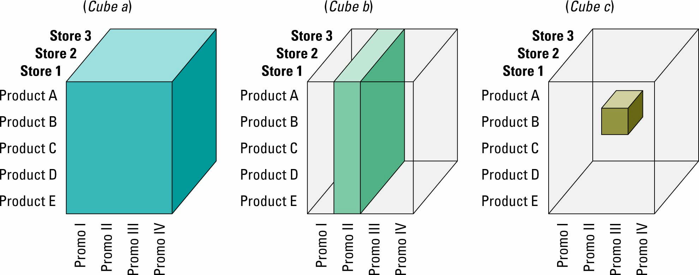
Multi-dimensional Analysis
Notes:
Users can slice and dice the cube to drill down into the information.
Cube A represents store information (the layers), product information (the rows), and promotion information (the columns).
Cube B represents a slice of information displaying promotion II for all products at all stores
Cube C represents a slice of information displaying promotion III for product B at store 2.
CLASSROOM EXERCISE
Analyzing Multiple Dimensions of Information
Jump! is a company that specializes in making sports equipment, primarily basketballs, footballs, and soccer balls. The company currently sells to four primary distributors and buys all of its raw materials and manufacturing materials from a single vendor. Break your students into groups and ask them to develop a single cube of information that would give the company the greatest insight into its business (or business intelligence) given the following choices:
Product A, B, C, and D,
Distributor X, Y, and Z,
Promotion I, II, and III,
Sales,
Season,
Date/Time,
Salespersons Karen and John, or,
Vendor Smithson.
Remember you can pick only 3 dimensions of information for the cube, they need to pick the best 3:
Product
Sales
Promotion.
These give the three most business-critical pieces of information.

Slide 15
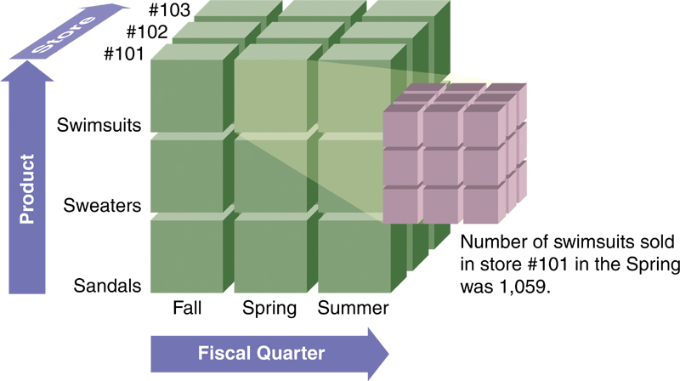
Multi-dimensional Analysis
Notes:
Users can slice and dice the cube to drill down into the information.
Cube A represents store information (the layers), product information (the rows), and promotion information (the columns).
Cube B represents a slice of information displaying promotion II for all products at all stores
Cube C represents a slice of information displaying promotion III for product B at store 2.
CLASSROOM EXERCISE
Analyzing Multiple Dimensions of Information
Jump! is a company that specializes in making sports equipment, primarily basketballs, footballs, and soccer balls. The company currently sells to four primary distributors and buys all of its raw materials and manufacturing materials from a single vendor. Break your students into groups and ask them to develop a single cube of information that would give the company the greatest insight into its business (or business intelligence) given the following choices:
Product A, B, C, and D,
Distributor X, Y, and Z,
Promotion I, II, and III,
Sales,
Season,
Date/Time,
Salespersons Karen and John, or,
Vendor Smithson.
Remember you can pick only 3 dimensions of information for the cube, they need to pick the best 3:
Product
Sales
Promotion.
These give the three most business-critical pieces of information.

Slide 16
Information Cleansing or Scrubbing
An organization must maintain high-quality data in the data warehouse.
Information cleansing or scrubbing – a process that weeds out and fixes or discards inconsistent, incorrect, or incomplete information.
Software tools use sophisticated algorithms to parse, standardize, correct, match and consolidate warehouse information.
Oracle, SAS, IBM
Notes:
What would happen if the information contained in the data warehouse was only about 70 percent accurate?
Would you use this information to make business decisions?
Is it realistic to assume that an organization could get to a 100% accuracy level on information contained in its data warehouse?
No, it is too expensive.

Slide 17
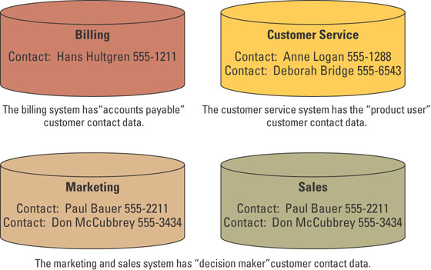
Information Cleansing or Scrubbing
Notes:
Taking a look at customer information highlights why information cleansing and scrubbing is necessary.
Customer information exists in several operational systems.
In each system all details of this customer information could change from the customer ID to contact information.
Determining which contact information is accurate and correct for this customer depends on the business process that is being executed.

Slide 18
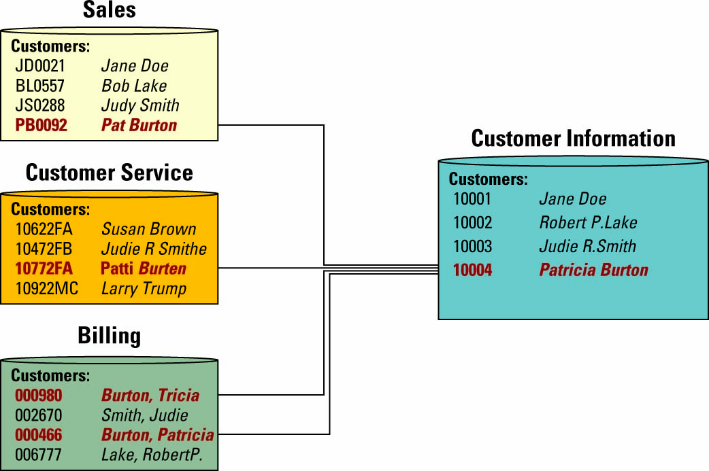
Information Cleansing or Scrubbing
Standardizing Customer name from Operational Systems
Notes:
Ask your students if they have ever received more than one piece of identical mail, such as a flyer, catalogue, or application.
If so, ask them why this might have occurred.
Could it have occurred because their name was in many different disparate systems?
What is the cost to the business of sending multiple identical marketing materials to the same customers?
Expense
Risk of alienating customers

Slide 19
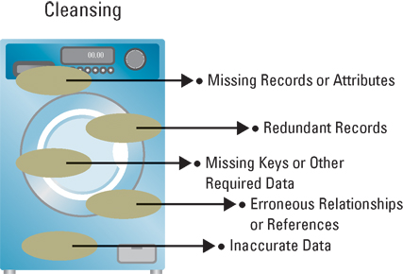
Information Cleansing or Scrubbing
Information cleansing allows an organization to fix these types of inconsistencies and cleans the data in the data warehouse

Slide 20
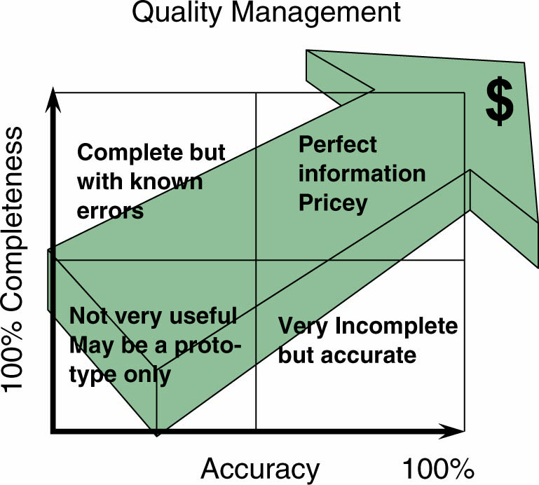
Information Cleansing or Scrubbing
The more complete and accurate an organization wants its information, the more it costs.
Notes:
Why do you think most businesses cannot achieve 100% accurate and complete information?
If they had to choose a percentage for acceptable information what would it be and why?
Some companies are willing to go as low as 20% complete just to find business intelligence
Few organizations will go below 50% accurate – the information is useless if it is not accurate
Achieving perfect information is almost impossible
The more complete and accurate an organization wants to get its information, the more it costs
The tradeoff between perfect information lies in accuracy versus completeness
Accurate information means it is correct, while complete information means there are no blanks
Most organizations determine a percentage high enough to make good decisions at a reasonable cost, such as 85% accurate and 65% complete

Slide 21
Building a Data Warehouse
Extract data from various source system files and databases
Transform, integrate, and load the data
Keep both detailed and summary data in a read-only environment
Access via query languages and analytical tools
Notes:
In a large organization may have dozens or hundreds of databases
Loading can take time – DND took a whole weekend
Both detailed and summary data is added to the database
Very involved analytical tools

Slide 22
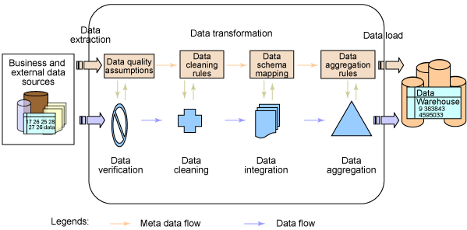
Data Warehouse
ETL – Extract, Transform, Load
Source: http://www.ibm.com/developerworks/data/library/techarticle/dm-0508gong/
Notes:
Good for small to medium sized companies
Limited hardware and software platforms
Homogeneous environments

Slide 23
Database versus Data Warehouse
 | Database | Data Warehouse
Supported Activity | Operational | Analytical
Response Time | Fast | Can be slow
Age of Data | Current transaction | Historical data
Scope | Limited area within organization | Provides view of entire organization
Data Variability | Changes often | Infrequent changes
Source | Transactions | Multiple sources
Data Model | Business rules | Aligns with overall business structure

Slide 24
Data Warehousing Benefits
End users can access data quickly and easily via Web browsers because they are located in one place
End users can conduct extensive analysis with data in ways that may not have been possible before
End users have a consolidated view of organizational data

Slide 25
Data Warehousing Issues
Can be very expensive to build and to maintain.
Incorporating data from obsolete mainframe systems can be difficult and expensive.
People in one department might be reluctant to share data with other departments.
Transferring of data from other systems, can go through a cleansing process that changes the information, meaning that the data is no longer a historical record and do not fully represent the actual accounting systems.

Slide 26
Data Marts
Because data warehouses are so expensive, they are mainly used by large companies.
Smaller companies use a lower-cost, scaled down version of a data warehouse called a data mart.
A data mart is a small data warehouse designed for the end-user needs in a specific business unit or a department.

Slide 27
Benefits of Data Marts
Data marts are far less costly than data warehouses. A typical Data Mart costs less than $100,000, compared with $1 million or more for a Data Warehouse.
Data Marts can be implemented more quickly, often in less than 90 days.
Data Marts contain less information than a Data Warehouses, resulting in more rapid response, are easier to learn and navigation is easier for the end user.
Data Marts support users of the data locally rather then centrally controlled by giving power or control to the users and user groups of the information being used.

Slide 28
OLAP and OLTP
Online analytical processing (OLAP) involves the analysis of accumulated data by end users (usually in a data warehouse).
Multi-dimensional analysis
In contrast to OLAP, online transaction processing (OLTP) typically involves a database, where data from business transactions are processed online as soon as they occur.

Slide 29
Online Transaction Processing (OLTP)
Immediate automated responses to the requests of users
Designed to handle multiple concurrent transactions
Plays a large role in electronic commerce applications
Notes:
Receiving user information, processing orders and generating sales receipts
What kind of design are you looking at? What are the constraints?
Fast response/Performance
Availability
Reliability
Security
Organization of the data is VERY important
Tuning the database is vitally important
Organizations must figure out the best way to gain value from the information

Slide 30
Online Analytical Processing (OLAP)
The use of graphical software tools that provide complex analysis of data stored in a database.
OLAP server is the chief component
Good for time series and trend analysis.
Enables user to “drill-down” into the data.
Notes:
OLAP server understands how the data is organized and has special functions for analyzing data
Hat effect on overall cost would a increase of food by 5% and a increase in size by 10%
Queries to give management decision support for planning
Can be VERY slow

Slide 31
Exercise
Work with a partner to review the main terms:
Data warehouse vs data mart – what’s the difference?
ETL – what does it stand for and mean?
Describe the concept of a cube.
What’s the difference between OLAP and OLTP?

Slide 32
Business Intelligence Definition
Once an organization has captured data and organized them into databases, data warehouses and data marks, it can use the data for further analysis.
Business Intelligence (BI) refers to applications and technologies for consolidating, analyzing, and providing access to vast amounts of data to help users make better business and strategic decisions.

Slide 33
How Business Intelligence Works

Slide 34
Characteristics of BI Systems
Reliable | The information has been documented as the certified or approved information for the enterprise. Can be used with confidence.
Consistent | The processes delivering the information are well documented. Information is complete. Processes run with predictable response times.
Understandable | The information has been defined in business terms. Calculations and algorithms can be accessed for comprehension. The data dictionary or metadata repository is easy to access and understand.
Easily Manipulated | It is easy to change the questions or set different parameters to turn and twist the information in new ways.
Notes:
CLASSROOM EXERCISE
Ask A Ninja.COM
If you need some insight into just about anything you can visit AskANija.com
http://askaninja.com/
I like to show this site to my students and ask why this site is so successful? Why would people assume that just because someone is dressed as a Nija they are knowledgeable about all subjects? This leads to a great discussion on how can you validate business intelligence. How do you know the data or analysis you are receiving is from a credible source? Can you prove the data is complete, accurate, etc?
Makes for an interesting classroom discussion.

Slide 35
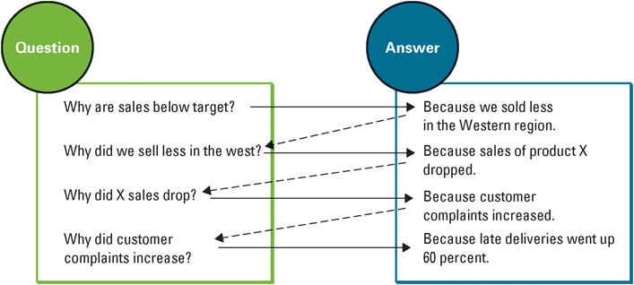
How BI Can Provide Answers
Notes:
The figure displays how organizations using BI can find the root causes to problems and provide solutions simply by asking “Why?” The process is initiated by analyzing a global report, say of sales per quarter.
Every answer is followed by a new question, and users can drill deep down into a report to get to fundamental causes.
Once they have a clear understanding of root causes, they can take highly effective action.
Finding the answers to tough business questions by using data that is reliable, consistent, understandable, and easily manipulated allows a business to gain valuable insight into such things as:
Where the business has been. Historical perspective is always important in determining trends and patterns of behavior.
Where it is now. Current situations are critical to either modify if not acceptable or encourage if they are trending in the right direction.
And where it will be in the near future. Being able to predict with surety the direction of the company is critical to sound planning and to creating sound business strategies.

Slide 36
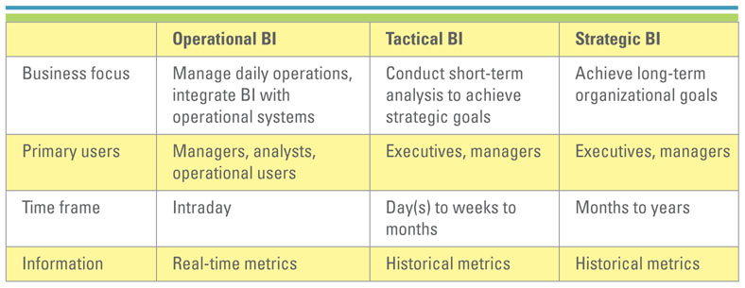
Operational, Tactical & Strategic BI
Notes:
CLASSROOM VIDEO
Microsoft BI Intelligence Videos
Excellent video to jumpstart your BI lecture.
Is there any business intelligence out there? Mike Arcuri, group program manager on the business intelligence team shows off Excel 12's new features for looking at how your business is doing. You'll never look at pivot tables the same way again.
http://video.aol.com/video-detail/business-intelligence-in-excel-2007/538243300

Slide 37
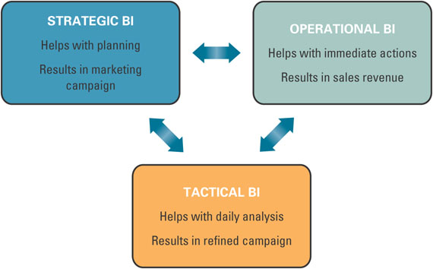
Strategic, Operational & Tactical BI
The three forms of BI must work towards a common goal.
Notes:
Strategic BI is used in the planning stages that are implemented with the help of Operational BI and refined with Tactical BI.
True Value Hardware has used BI software to improve distribution efficiency and reduce inventory cost by US$50 million. The marketing department tracks the popularity of promotions by store or region and, using historic data from its data warehouse, ensures stores have adequate inventory. The companies investment in BI achieve a positive ROI in five or six months.

Slide 38
BI’s Operational Value (1)
Data latency is the time needed to make transactional data ready for analysis.
The time for extracting, transforming and cleansing the data
Analysis latency is the time from which data is made available and analysis of it is completed.
Decision latency is the time it takes a human to comprehend the analysis and take appropriate action.

Slide 39
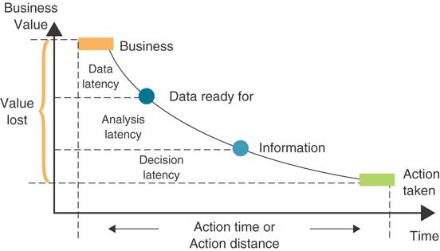
BI’s Operational Value (2)
Notes:
Data latency is the time needed to make transactional data ready for analysis.
Analysis latency is the time from which data is made available and analysis of it is completed.
Decision latency is the time it takes a human to comprehend the analysis and take appropriate action.
Walk students through the diagram which illustrates response time and business value.
The longer or farther it takes to implement a decision, the less business value there is as a result.
The horizontal axis is time or distance. The vertical axis is business value. The curve shows diminishing returns across the time/distance horizon.
The curve is segmented by the stages of getting the business, acquiring the data, transforming into information and finally taking action.
With Strategic, Operational and Tactical BI the lags diminish and business value is added.

Slide 40
BI’s Operational Value (3)
The key is to shorten these latencies so that the time frame for opportunistic influences on customers is faster and better positioned.
The best time to influence customers is while they are still in the store or on the website.

Slide 41

Data Mining
Searching for valuable business information in a large database or data warehouse
Data mining performs two basic operations:
Predicting trends and behaviors
Identifying previously unknown patterns and relationships

Slide 42
Data Mining Examples
Targeted marketing – use data from past promotional mailings to identify people who are more likely to respond in the future.
Find hidden patterns – analyze retail sales data to discover unrelated products that are purchased together.
Detecting fraudulent credit card transactions – tracks patterns of credit card use and identifies abnormal patterns

Slide 43
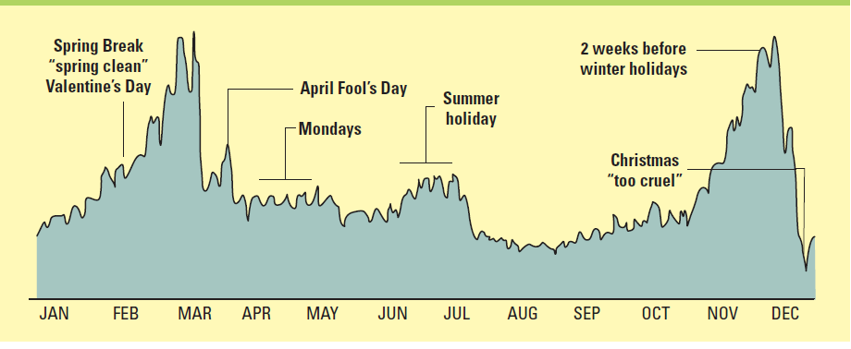
Data Visualization
Analysts can put together data and visualize it to reveal interesting correlations, inherent trends and patterns in information.
Source: David McCardless, Information is Beautiful (2009), Collins, London, UK, pg. 179
Notes:
Analysts can put together data and visualize it to reveal interesting correlations, inherent trends and patterns in information.
Have your students visit Information is Beautiful, Ideas, Issues, Knowledge, data—visualized. Here they can, in the words of the web site, “Slice, dice and flip data … with these interactive visualizations.”

Slide 44
Data Mining Techniques
The most common data mining algorithms:
Cluster analysis
Association detection
Statistical analysis

Slide 45
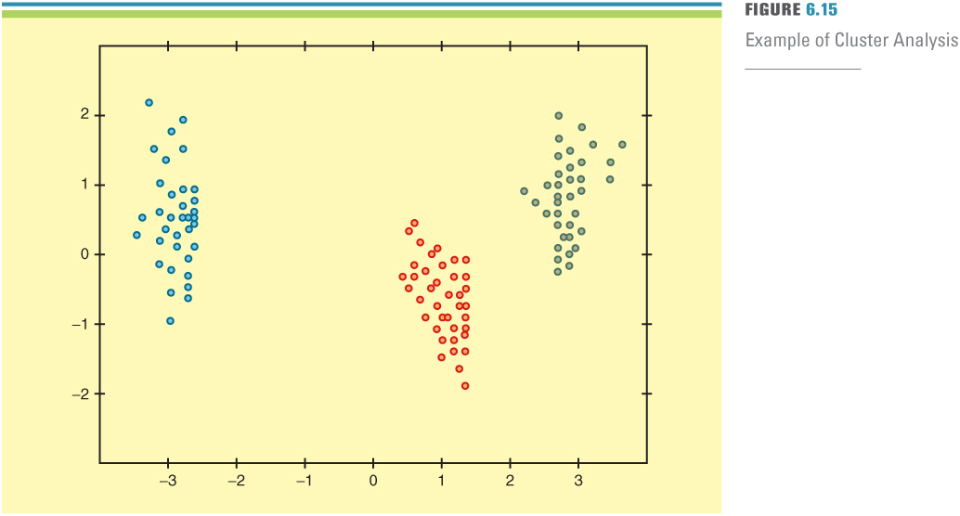
Data Mining Techniques
Cluster analysis – A statistical technique used to divide an information set into mutually exclusive groups such that the members of each group are as close together as possible to one another and the different groups are as far apart as possible.
Ex: Postal code segmenting
Notes:
Some examples of cluster analysis include:
Consumer goods by content, brand loyalty or similarity
Product market typology for tailoring sales strategies
Retail store layouts and sales performances
Corporate decision strategies using social preferences
Control, communication, and distribution of organizations
Industry processes, products, and materials
Design of assembly line control functions
Character recognition logic in OCR readers
Data base relationships in management information systems

Slide 46
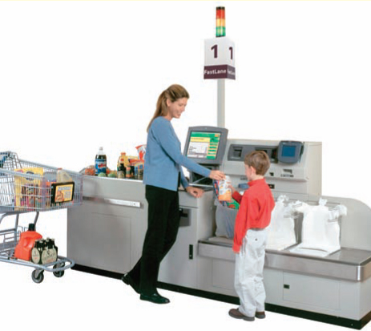
Data Mining Techniques
Association detection – Reveals the relationship between variables along with the nature and frequency of the relationships
Ex: Market basket analysis
Notes:
Maytag uses association detection to ensure that each generation of appliances is better than the previous generation
Maytag’s warranty analysis tool automatically detects potential issues, provides quick and easy access to reports, and performs multidimensional analysis on all warranty information
Market basket analysis – analyzes such items as Web sites and checkout scanner information to detect customers’ buying behavior and predict future behavior by identifying affinities among customers’ choices of products and services

Slide 47
Data Mining Techniques
Statistical analysis – Performs such functions as information correlations, distributions, calculations, and variance analysis
Forecast – Predictions made on the basis of time-series information
Time-series information – Time-stamped information collected at a particular frequency
Notes:
Kraft uses statistical analysis to assure consistent flavor, color, aroma, texture, and appearance for all of its lines of foods
Kraft evaluates every manufacturing procedure, from recipe instructions to cookie dough shapes and sizes to ensure that the billions of Kraft products that reach consumers each year taste great (and the same) with every bite
Nestle Italiana uses data mining and statistical analysis to determine production forecasts for seasonal confectionery products
The company’s data-mining solution gathers, organizes, and analyzes massive volumes of information to produce powerful models that identify trends and predict confectionery sales

Slide 48
Data Mining - RFM Analysis
A simple data mining algorithm
A way of analyzing and ranking customers according to their purchase patterns.
Considers :
R – how recently a customer ordered
F – how frequently a customer orders
M – how much money the customer spends per order

Slide 49
Data Mining - RFM Analysis
Customers grouped into 5 groups and given a score between 1 – 5
The 20% with the most recent orders score R = 1
The 20% with the least recent orders score R = 5
The 20% with the most frequent orders score F = 1
The 20% with the least frequent orders score F = 5
The 20% with the most expensive orders score M = 1
The 20% with the least expensive orders score M = 5

Slide 50
Business Benefits of BI
Single Point of Access for all Users.
BI across Organizational Departments.
Up-to-the-Minute Information for Everyone.
Categories of BI benefits:
Direct quantifiable benefits.
Indirect quantifiable benefits.
Unpredictable benefits.
Intangible benefits.
Notes:
Single Point of Access for all Users.
All authorized users can access the central depository of data and analysis to create reports relevant to their needs. BI provides an easy-to-understand, non-technical, graphical user interface.
BI across Organizational Departments.
Can be used at every step in the value chain.
Ask students to reflect on Porter’s Primary Activities. How would sales transactions data improve performance at each stage?
Ans. Answers will vary but examples would include: inbound logistics: prediction of necessary raw materials for future production; operations: scheduling and capacity optimization; outbound logistics: scheduling and capacity optimization; marketing and sales: optimizing the promotional campaign cycle, sales quotas; service: prediction of requirements.
Up-to-the-Minute Information for Everyone
Real time updates and scenario generation. Master Card Worldwide monitors day-to-day operations. It uses dynamically generated analysis to limit credit card fraud.
Categories of BI benefits:
Direct quantifiable benefits. Benefits to which actual metrics such as amount of dollars saved, amount of response time reduced.
Indirect quantifiable benefits. A benefit such as improved response time that may be due to other factors that BI but initial impetus may have been because of a business intelligence consciousness or a benefit that is due to other factors as well as BI.
Unpredictable benefits. Pleasant surprises such as analysis revealing a new targert market or a new use for an old product.
Intangible benefits. A general expectation that the change will positively impact the bottom line but cannot be immediately measured. Examples would include improved customer satisfaction and improved product quality ratings.

Slide 51
Types of Business Intelligence Systems
Two types of BI Systems:
Those that provide data analysis tools
Multidimensional data analysis (or online analytical processing)
Data mining
Decision support systems
Those that provide information in structured format
Dashboards

Slide 52
Common BI Software Packages
SAS
Hyperion (Oracle)
SAP Business Objects
IBM Cognos
SPSS

Slide 53
Decision Support Systems
Decision Support Systems (DSSs) - computer-based information systems that combine models and data in an attempt to solve semi-structured and some unstructured problems with extensive user involvement.

Slide 54
DSS Capabilities
Sensitivity analysis - the study of the impact that changes in one (or more) parts of a model have on other parts.
What-if analysis - the study of the impact of a change in the assumptions (input data) on the proposed solution.
Goal-seeking analysis - the study that attempts to find the value of the inputs necessary to achieve a desired level of output

Slide 55
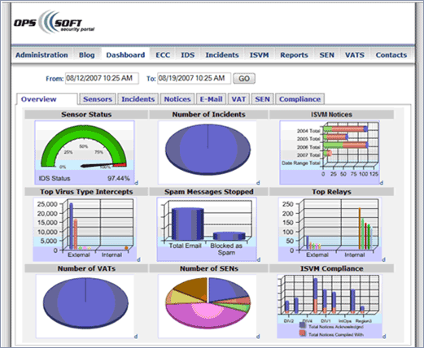
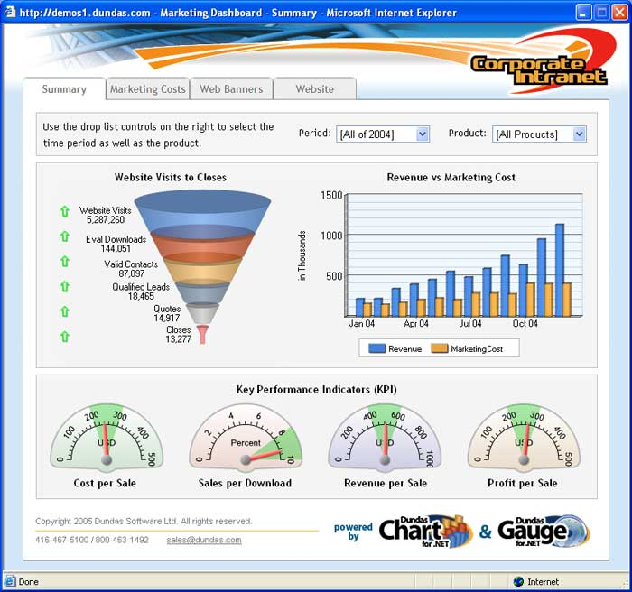
Digital Dashboards
Dashboards:
Provide rapid access to timely information.
Provide direct access to management reports.
Are very user-friendly and supported by graphics.
Samples of Performance Dashboard

Slide 56
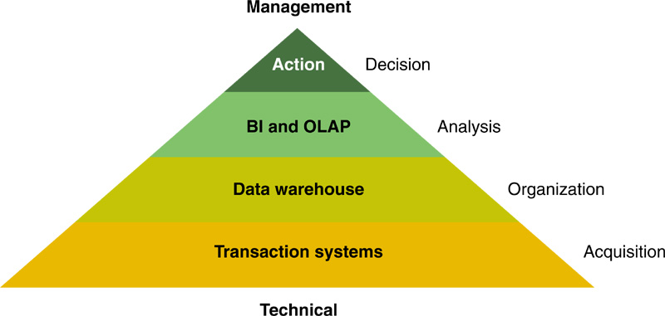
The Business Intelligence Pyramid

Slide 57
Case Study: Dell
How does Dell use IT to differentiate itself from its primary competitor in terms of its direct sales and distribution of its products?
What Business Intelligence and Decision Support Systems is Dell using? How do they improve sales/service?

